Slide 1

OPENCV项目实战
02 opencv模块介绍
主讲人：龙鹏

Slide 2
本节目标
  核心功能模块介绍
  图像处理与特征模块介绍
  传统机器学习模块介绍
  深度学习模块介绍
Notes:
本页PPT标题固定为“本节目标”
项目符号与文本中间使用一个空格分隔
使用图片标准重点目标

Slide 3

OpenCV模块汇总
core. Core functionality
imgproc. Image Processing
imgcodecs. Image file reading and writing
videoio. Video I/O
highgui. High-level GUI
video. Video Analysis
calib3d. Camera Calibration and 3D Reconstruction
features2d. 2D Features Framework
objdetect. Object Detection
dnn. Deep Neural Network module
ml. Machine Learning
flann. Clustering and Search in Multi-Dimensional Spaces
photo. Computational Photography
stitching. Images stitching
gapi. Graph API

Slide 4

核心功能模块介绍
  Core
    OpenCV基本数据结构
    动态数据结构
    绘图函数
    数组操作相关函数
    辅助功能与系统函数和宏
    与OpenGL的互操作

Slide 5
图像处理与特征模块介绍
  imgproc
    线性和非线性的图像滤波
    图像的几何变换
    图像转换
    直方图
    结构分析和形状描述
    运动分析和对象跟踪
    特征检测
    目标检测

Slide 6
图像处理与特征模块介绍
  Feature2d
    AffineFeature2D，BoostDesc，BriefDescriptorExtractor，DAISY，Elliptic_KeyPoint，FREAK，HarrisLaplaceFeatureDetector，LATCH，LUCID，MSDDetector，MSDDetector，PCTSignaturesSQFD，SIFT，StarDetector，SURF，VGG等图像特征
Notes:
https://docs.opencv.org/trunk/d0/d13/classcv_1_1Feature2D.html
https://blog.csdn.net/u012679707/article/details/79505279

Slide 7
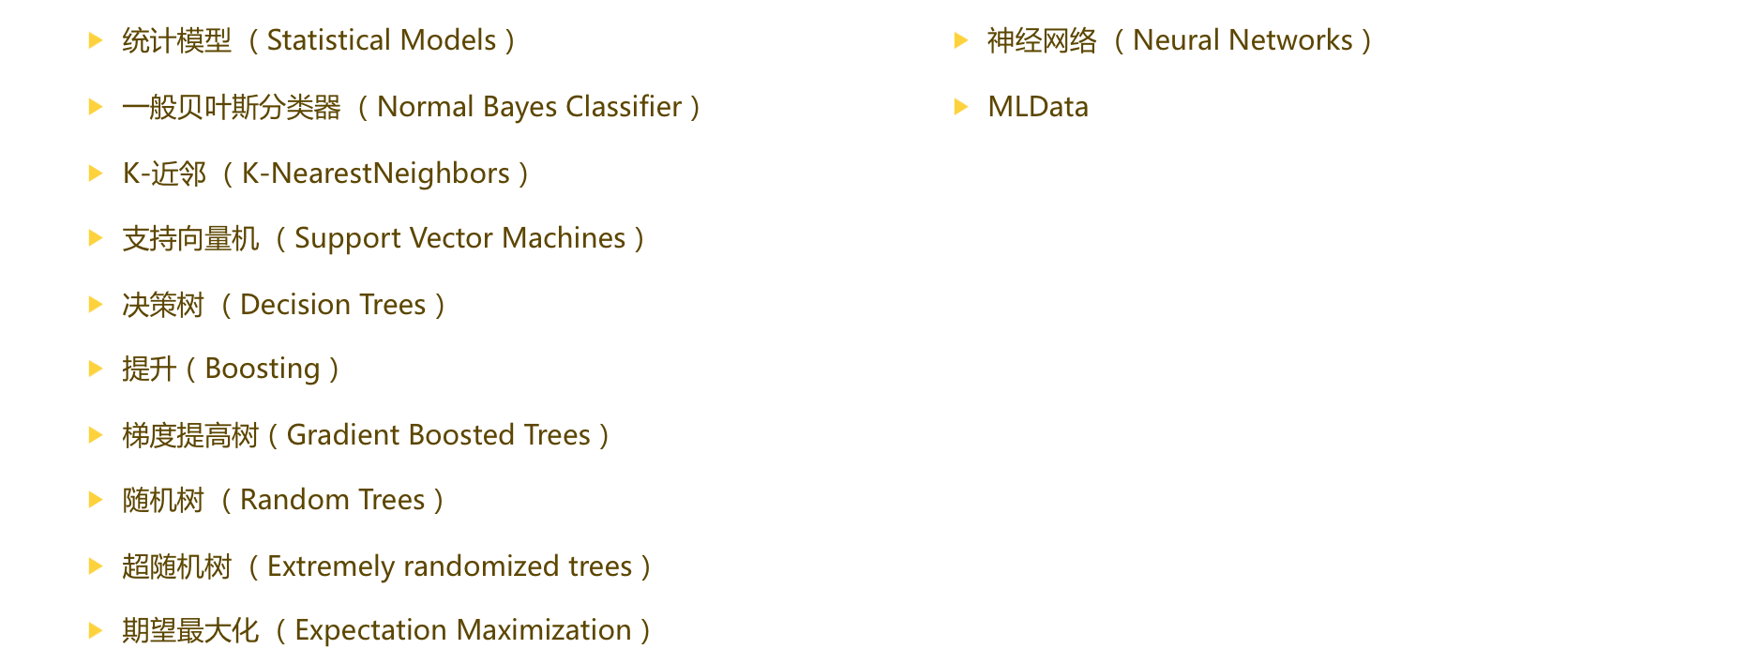
传统机器学习模块

Slide 8
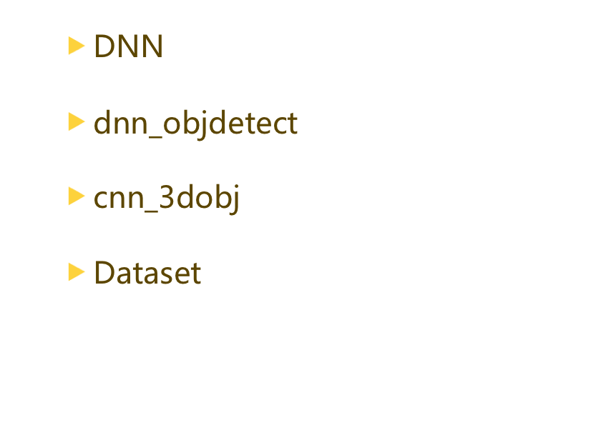
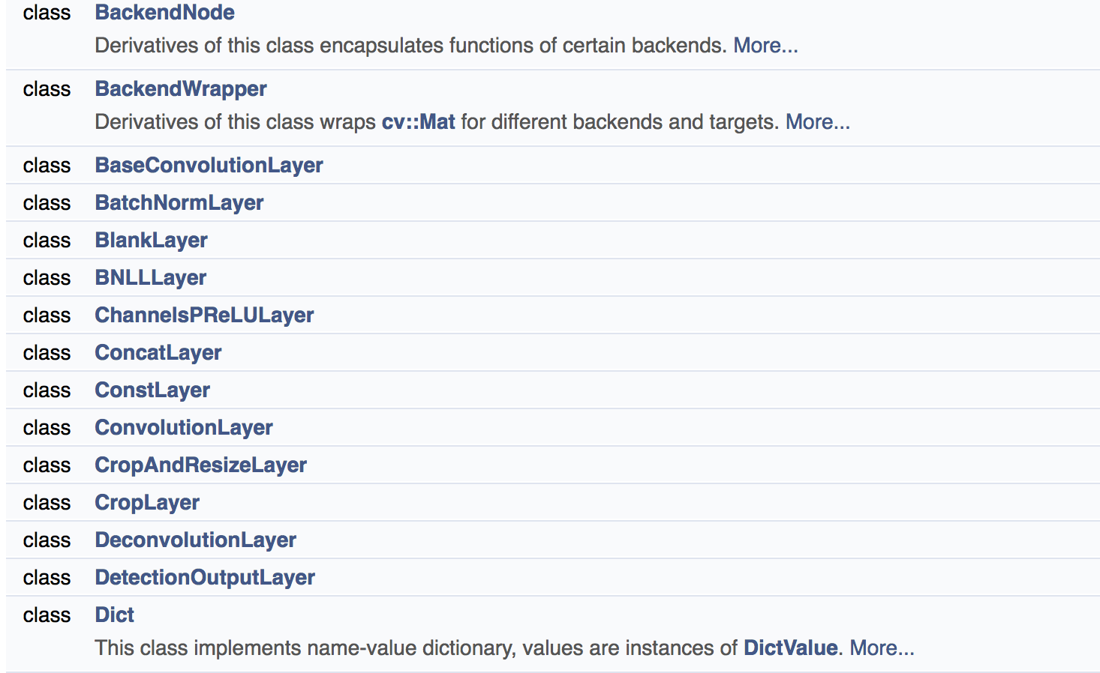
深度学习模块

Slide 9
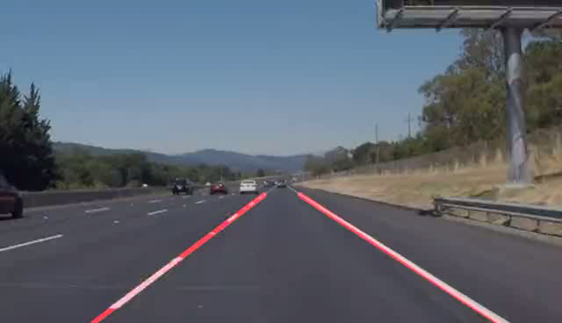
实战——车道线识别

Slide 10
实战——车道线识别
    def roi_mask(img, vertices):
    mask = np.zeros_like(img)
    if len(img.shape) > 2:
    channel_count = img.shape[2]
    mask_color = (255,) * channel_count
    else:
    mask_color = 255
    cv2.fillPoly(mask, vertices, mask_color)
    masked_img = cv2.bitwise_and(img, mask)
    return masked_img
    def draw_roi(img, vertices):
    cv2.polylines(img, vertices, True, [255, 0, 0], thickness=2)

Slide 11
实战——车道线识别
    def draw_lines(img, lines, color=[255, 0, 0], thickness=2):
    for line in lines:
    for x1, y1, x2, y2 in line：
    cv2.line(img, (x1, y1), (x2, y2), color, thickness)
    def hough_lines(img, rho, theta, threshold, min_line_len, max_line_gap):
    lines = cv2.HoughLinesP(img, rho, theta, threshold, np.array([]), minLineLength=min_line_len, maxLineGap=max_line_gap)
    line_img = np.zeros((img.shape[0], img.shape[1], 3), dtype=np.uint8)
    draw_lanes(line_img, lines)
    return line_img

Slide 12
实战——车道线识别
    def draw_lanes(img, lines, color=[255, 0, 0], thickness=8):
    left_lines, right_lines = [], []
    for line in lines:
    for x1, y1, x2, y2 in line:
    k = (y2 - y1) / (x2 - x1)
    if k < 0:
    left_lines.append(line)
    else:
    right_lines.append(line)
    if (len(left_lines) <= 0 or len(right_lines) <= 0):
    return img

Slide 13
实战——车道线识别
    def clean_lines(lines, threshold):
    slope = [(y2 - y1) / (x2 - x1) for line in lines for x1, y1, x2, y2 in line]
    while len(lines) > 0:
    mean = np.mean(slope)
    diff = [abs(s - mean) for s in slope]
    idx = np.argmax(diff)
    if diff[idx] > threshold:
    slope.pop(idx)
    lines.pop(idx)
    else:
    break

Slide 14
实战——车道线识别
    def calc_lane_vertices(point_list, ymin, ymax):
    x = [p[0] for p in point_list]
    y = [p[1] for p in point_list]
    fit = np.polyfit(y, x, 1)
    fit_fn = np.poly1d(fit)
    xmin = int(fit_fn(ymin))
    xmax = int(fit_fn(ymax))
    return [(xmin, ymin), (xmax, ymax)]

Slide 15
实战——车道线识别
    def process_an_image(img):
    roi_vtx = np.array([[(0, img.shape[0]), (460, 325), (520, 325), (img.shape[1], img.shape[0])]])
    gray = cv2.cvtColor(img, cv2.COLOR_RGB2GRAY)
    blur_gray = cv2.GaussianBlur(gray, (blur_ksize, blur_ksize), 0, 0)
    edges = cv2.Canny(blur_gray, canny_lthreshold, canny_hthreshold)
    roi_edges = roi_mask(edges, roi_vtx)
    line_img = hough_lines(roi_edges, rho, theta, threshold, min_line_length, max_line_gap)
    res_img = cv2.addWeighted(img, 0.8, line_img, 1, 0)

Slide 16
小结
重点归纳
  基础函数API的熟悉
  传统图像特征包含了哪些描述子？
  深度学习如何使用，都支持什么框架？

